Slide 1
Value Objects
Prof. Dr. Dirk Riehle
Friedrich-Alexander University Erlangen-Nürnberg
ADAP C07
Licensed under CC BY 4.0 International
Notes:
It is Friedrich-Alexander University Erlangen-Nürnberg – FAU, in short.
Corporate identity wants us to say “Friedrich-Alexander University”.

Slide 2
Values
Are timeless abstractions
  No life-cycle, no birth or death, no change
  No identity, cannot be counted, there is only one “copy”
Consequences for programming
  Often implemented as immutable objects
  Program state changes by assigning values to fields
Values are instances of value types
  Also often called “data” and “data types”
  We avoid the potential confusion

Slide 3
Objects
Are virtual or physical entities from the modeled world
  Exist in time, have a life-cycle
  Can be created, changed, shared, destroyed
  Have identity independent of internal structure
Consequences for programming
  Can be implemented as traditional classes with mutable state
  Leads to side-effects a.k.a. aliasing and source of bugs
Objects are instances of object types (classes)

Slide 4
Examples of Value Types
So-called “primitive data types”
  Numbers, strings, characters, …
Common general value types
  Names, coordinates, postal codes, …
Domain-specific value types
  SI unit (quantity units), ranges, restrictions, ...
  Currency, monetary amount, interest rate, stock ticker symbol, …
  Protocol names, URLs, HTTP return codes, …
  …

Slide 5
Value and Object Representations
Shared Inter-subjective Immaterial Reality
2 : Integer
EUR 42 : Money
sa12 : SavingsAccount
Shared Material “Physical” Reality
“II” on paper
“EUR 42” on statement
sa12 as booklet
“zwei” on paper
€42 as cash
sa12 in audit trail
Software System
10
“2”
2.0
42
€
42.0
sa12 : SA
sa12 : SA

Slide 6
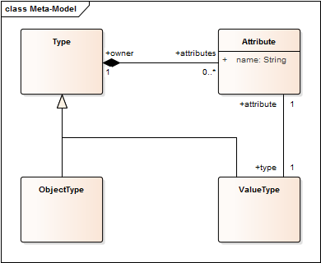
Objects and Values
A software system consists of both objects and values
  Object attributes
  have values
The system is an
object graph with
values as leaves

Slide 7
Benefits of Domain-Specific Value Types
Brings program closer to problem domain
Restrains a major source of possible bugs (aliasing)
May enhance system performance (see implementation)

Slide 8
Quiz: Modeling PostalAddress
How would you model a PostalAddress class?
  As a value type
  As an object type
  As something else

Slide 9
Answer: Modeling PostalAddress
How would you model a PostalAddress class?
  As a value type
    Conceptually: Yes. A postal address does not have a life-cycle and does not change.
    Pragmatically: No. May be too heavyweight, with little sharing possible.
  As an object type
    Conceptually no, pragmatically yes. See above.
  As something else
    Tertium non datur.

Slide 10
Implementation 1 / 4: General Semantics
Implement java.lang.Object equality contract correctly
public boolean equals(Object o) {
if ((o == null) || !(o instanceof Name)) return false;
Name n = (Name) o;
int noComponents = getNoComponents();
if (n.getNoComponents() != noComponents) return false;
for (int i = 0; i < noComponents; i++) {
if (!getComponent(i).equals(n.getComponent(i))) return false;
}
return true;
}
public int hashCode() {
return asString().hashCode();
}

Slide 11
Implementation 2 / 4: Immutability
Value types as classes defining immutable objects
  Do not change the state of the object; rather return a new one
    Affects the interface; no mutation methods of return type void
    Use Java’s final fields to ensure immutability
    Adjust client code to accept new object
public Name remove(int i) {
assertIsValidIndex(i);
...
Name result = doRemove(i);
...
}
protected Name doRemove(int index) {
int newSize = getNoComponents() - 1;
String[] newComponents = new String[newSize];
... // copy components skipping component at index
return getName(newComponents);
}

Slide 12
Implementation 3 / 4: Sharing
Value types as classes defining shared objects
public Name getName(String[] components) {
return getStringArrayName(component);
}
public StringArrayName getStringArrayName(String[] components) {
String nameString = NameHelper.asNameString(components);
StringArrayName result = allStringArrayNames.get(nameString);
if (result == null) {
synchronized (this) {
result = allStringArrayNames.get(nameString);
if (result == null) {
result = new StringArrayName(components);
allStringArrayNames.put(nameString, result);
}
}
}
return result;
}

Slide 13
Benefits of Sharing Value Objects
Trivial equality contract implementation
More difficult if you have different implementation classes
public boolean equals(Object o) {
return this == o;
}
public int hashCode() {
return super.hashCode();
}

Slide 14
Implementation 4 / 4: Handle / Body Idiom
Handle / Body Idiom [C95]
  Pass around only the handle, which holds the body
  Forward all method calls from handle to body
Copy-on-write (mutation method call)
  Upon mutation method call to handle, copy body
  This way, the client gets isolated from source context
Benefits of handle / body idiom
  Protects client from aliasing effects
  Minimizes memory consumption

Slide 15
Implementation Benefits of Value Objects
Immutable objects are
  Safe for concurrency
  Perform well (no need for synchronization)
Shared objects
  Make equality easy to implement
  Minimize memory consumption
No identity of value objects allows for free copying
  Database benefit: No need for separate database table
  Serialization benefit: Value object can be serialized in-line
  Distributed systems benefit: No cross-process reference

Slide 16
Quiz: Implementing Base Contracts
How to implement on java.lang.Object
  For either a value or an object type
    These comparison methods …
      boolean isSame(Object o)
      boolean equals(Object o)
    These creation methods …
      Object clone()
      Constructor
    These other methods …
      int hashCode()
      getId()

Slide 17
Answer: Implementing Base Contracts
Value types
  These comparison methods …
    boolean isSame(Object o)
      N/A
    boolean equals(Object o)
      By attribute comparison
  These creation methods …
    Object clone()
      return this;
    Constructor
      Is hidden when sharing values
  These other methods …
    int hashCode()
      Calculate hash function
    getId()
      return ids.get(hashCode())
Object types
  These comparison methods …
    boolean isSame(Object o)
      return this == o;
    boolean equals(Object o)
      By attribute comparison
  These creation methods …
    Object clone()
      Create shallow clone
    Constructor
      Whatever
  These other methods …
    int hashCode()
      return super.hashCode()
    getId()
      Safe version of return (int) this

Slide 18
Design Exercise
Design a function that accepts a distance and a speed as input and returns the time it takes to go that distance at that speed

Slide 19
Missing Information
Functional properties
  Precision of calculation? (Assume double)
  What types of units? (Assume metric system)
  Handling of decimal multiples (Assume no)
  …
Non-functional properties
  Speed of calculation? (Assume as fast as possible)
  Concurrent computations? (Assume yes)
  Behavior in boundary cases? (Assume ignore)
  ...

Slide 20
Solution in Pseudo Code
function calculate_duration
in: speed
in: distance
out: duration
begin
duration = distance / speed
end

Slide 21
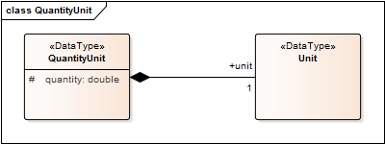
QuantityUnit

Slide 22
Base Units (of the Metric System)
Quantity | Base Unit | Symbol
Length | meter | m
Mass | kilogram | kg
Time | second | s
Electric Current | ampere | A
Thermodynamic Temperature | kelvin | K
Luminous Intensity | candela | cd
Amount of Substance | mole | mol

Slide 23
State Pattern vs. enum
public enum BaseUnit {
m(0),
kg(1),
s(2),
A(3),
K(4),
cd(5),
mol(6);
}

Slide 24
Unit (of Measure)
public class Unit {
// example: m/s = { 1.0, 0, -1.0, 0, 0, 0, 0 }
protected double exponents[7];
...
}

Slide 25
Quantities with Units
public class QuantityUnit {
protected double quantity;
protected Unit unit;
...
}

Slide 26
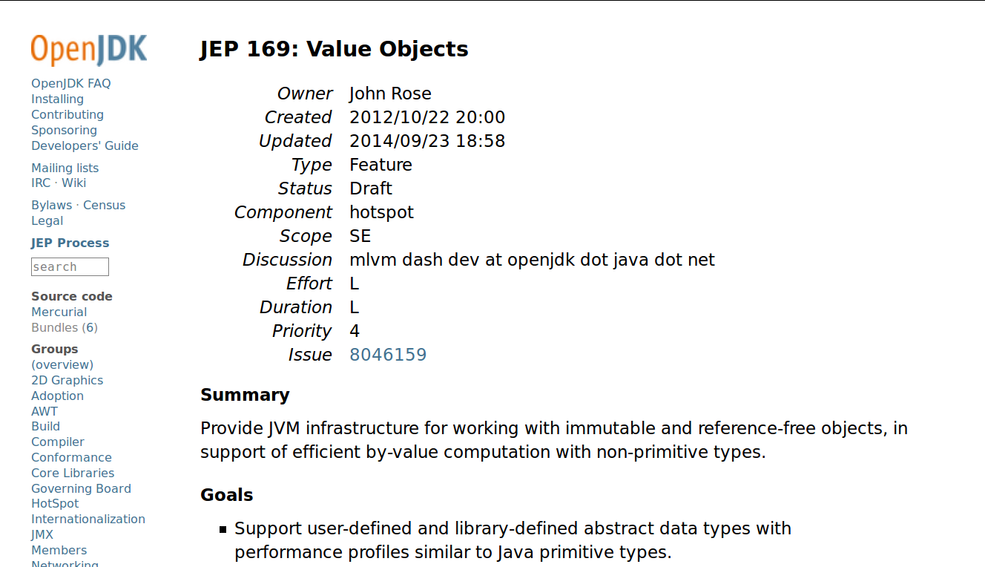
Value Types in Java
Not yet, but …

Slide 27
Value Type Constructors
Arrays
Enumerations
Parameterized types
  Quantity units (SI units)
  Ranges and range bounds
  Expressions, restrictions
  ...

Slide 28
Enums as Value Type Constructors
Enumerations provide shared values
  Constructors can only be private
  Fields can be mutable, however

Slide 29
Param. Types as Value Type Constructors
public class RangeRestriction<T extends Comparable<T>>
extends Restriction<T> {
protected Range<T> range;
public RangeRestriction(T lowerBound, T upperBound) {
this(new Range<T>(lowerBound, upperBound));
}
public RangeRestriction(Range<T> range) {
this.range = range;
}
@Override
public boolean isSatisfiedBy(T value) {
return range.includes(value);
}
}

Slide 30
Object Identifiers / References
Plain main memory reference
Handle (specialized pointers)
External object identifiers
Primary key to relation

Slide 31
Reality Check [B+97]
Large financial system (1997)
  More than 2500 (regular) C++ classes
Utilization of value object (classes)
  About 50 unique value types (implemented as classes)
  About 20 unique value type constructors
  More than 200 code (enum) like value types

Slide 32
The JValue Value Object Framework
JValue, originally a framework for value objects in Java
  Since 1998 but in its third (modern Java) incarnation
  Only recently on http://github.com/jvalue/value-objects
Contributions are welcome! Final theses possible as well.

Slide 33
Review / Summary of Session
Value objects / types
  Definition, charteristics, benefits
  Values vs. objects
  Implementation strategies
Examples

Slide 34
Thanks! Questions?
dirk.riehle@fau.de – http://osr.cs.fau.de
dirk@riehle.org – http://dirkriehle.com – @dirkriehle
DR

Slide 35
Credits and License
Original version
  © 2012-2018 Dirk Riehle, some rights reserved
  Licensed under a Creative Commons Attribution 4.0 International License
Contributions
  ...

